Slide 1
Note 10 Working with semi-structured data
CSC134
Dr. Haiquan Chen

Slide 2
Definitions
Structured data
Organized according to a formal data model (i.e., relational data model)
Semi-structured data
No formal data model, but contains symbols to separate and label data elements
Unstructured data
No data model and no pre-defined organization
MySQL, Oracle, SQL Server
CSV, XML, JSON
Text documents, images

Slide 3
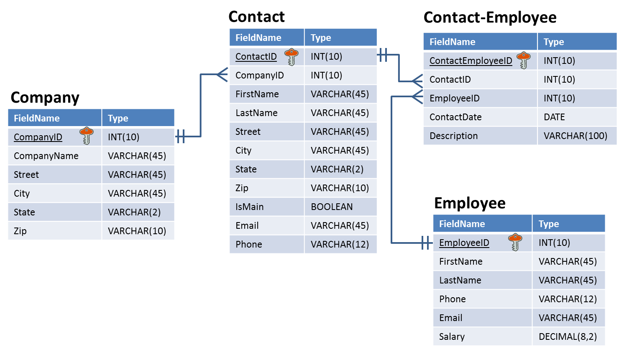
Relational databases are highly structured
Tables have the same number of fields for every record
Each field has a specified data type (field length)
Tables are connected using foreign keys

Slide 4
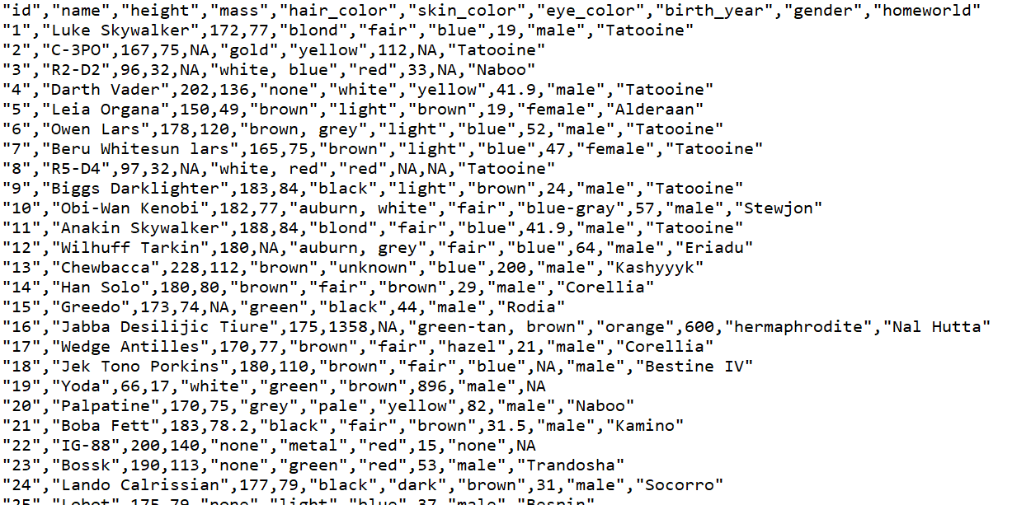
not all data is structured
No data type defined in each field.
Each value is separated by a comma.
This is a comma-separated value (CSV) file.

Slide 5
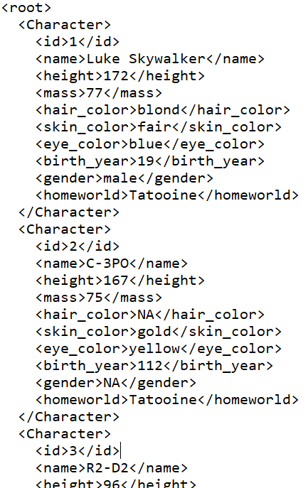
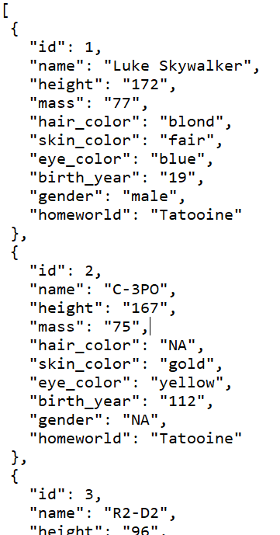
Alternatives to CSV for semi-structured data
XML
Extensible Markup Language
JSON
JavaScript Object Notation

Slide 6
XML Example
Plain text file
Uses text for values between tags for labels, like HTML <opening tag>data</closing tag> <height>172</height>
Values can be of any length
Fields can be skipped… Remove <mass>75</mass> from C-3PO and skin color is still gold
Starts and ends with a tag (often <root> or <document>)

Slide 7
Hierarchies in XML
We know we can break up name into first and last
But we are also nesting it under name
So first and last are now attributes of name
Easier to find what you’re looking for and organize your data
<Character>
<id>1</id>
<name>
<first>Luke</first> <last>Skywalker</last>
</name>
<height>172</height>
<mass>77</mass>
<hair_color>blond</hair_color>
<skin_color>fair</skin_color>
<eye_color>blue</eye_color>
<birth_year>19</birth_year>
<gender>male</gender>
<homeworld>Tatooine</homeworld>
</Character>
And id, name, height, mass, etc., are all nested under Character

Slide 8
Object and Array in JSON
Object/Dictionary
Array
Objects are surrounded by curly braces {}
There is a colon between the name and the value
Pairs are separated by commas
Objects are written in key/value pairs.
{ Key1: Value1, Key2: Value2, …}
Array is surrounded by square bracket [].
Array can store multiple values.
Values must be separated by comma
[ Value1, Value2, Value3, … ]

Slide 9
JSON (standard for transferring data on web)
Plain text file
Organized as objects within braces { }
Uses key-value pairs
key: value “name”: “C-3PO”
keys are field names; strings in quotes
values are the data; strings, numbers, Boolean (quotes around strings required)
a comma separates the key-value pairs
Values can be any length
Fields can be skipped
Remove “mass”: “75” from C-3PO and skin color is still gold
JSON object
JSON object

Slide 10
Hierarchies in JSON
We can have first and last nested as attributes of name, just like XML
We can list multiple abilities using array
{
"Character": {
"id": "1",
"name": {
"first": "Luke",
"last": "Skywalker"
},
"height": "172",
"mass": "77",
“Abilities": [
“Lightsaber",“Multilingual“
],
"skin_color": "fair",
"eye_color": "blue",
"birth_year": "19",
"gender": "male",
"homeworld": "Tatooine"
}
}
JSON object
JSON array

Slide 11
Same data, four different ways…
Relational database table
XML file
JSON file
first | last | year | GPA
Bob | Smith | Sophomore | 3.4
Judy | Jones | Senior | 3.9
Barbara | Watkins | Junior | 3.2
<root>
<Person>
<first>Bob</first>
<last>Smith</last>
<year>Sophomore</year>
<GPA>3.4</GPA>
</Person>
<Person>
<first>Judy</first>
<last>Jones</last>
<year>Senior</year>
<GPA>3.9</GPA>
</Person>
<Person>
<first>Barbara</first>
<last>Watkins</last>
<year>Junior</year>
<GPA>3.2</GPA>
</Person>
</root>
[
{
"first": "Bob",
"last": "Smith",
"year": "Sophomore",
"GPA": 3.4
},
{
"first": "Judy",
"last": "Jones",
"year": "Senior",
"GPA": 3.9
},
{
"first": "Barbara",
"last": "Watkins",
"year": "Junior",
"GPA": 3.2
}
]
CSV file
first,last,year,GPA
Bob,Smith,Sophomore,3.4
Judy,Jones,Senior,3.9
Barbara,Watkins,Junior,3.2

Slide 12






JSON and Web APIs
Web Application Program Interface (API)
Software that allows you to send and receive data through a web interface
Web APIs are just a way of getting data
Some examples
https://developer.twitter.com/en/docs/twitter-api
https://developers.google.com/maps/documentation/places/web-service/search-find-place

Slide 13
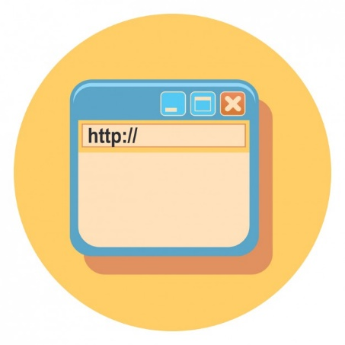
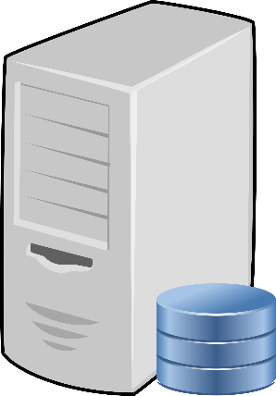
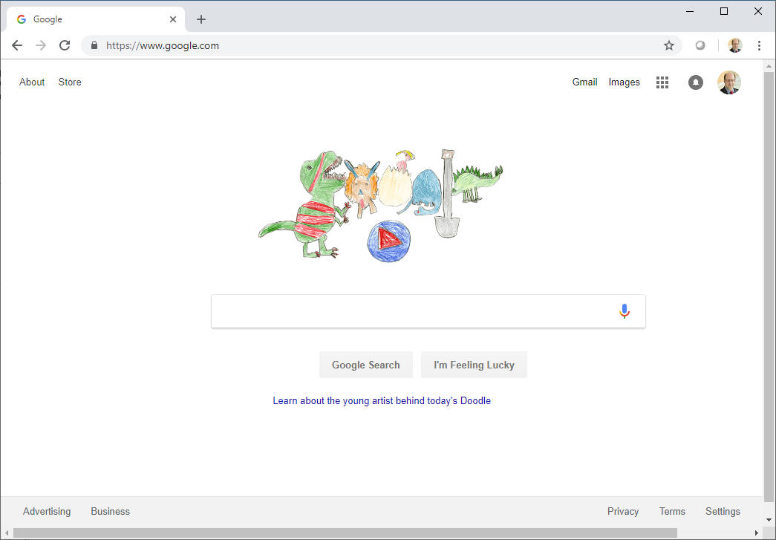
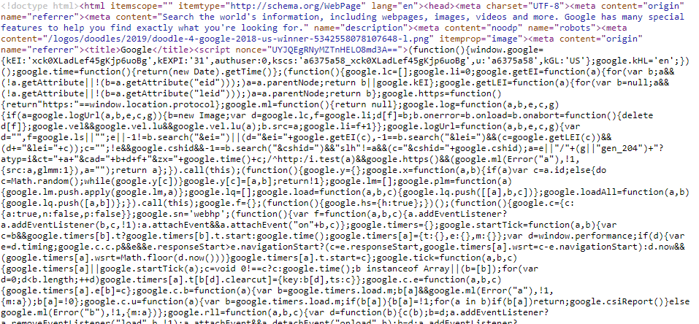
Requesting a web page from web server
Google’s Web Server
REQUEST: http://www.google.com
RESPONSE:
which is really…
This is a mixture of HTML and JavaScript and CSS..

Slide 14
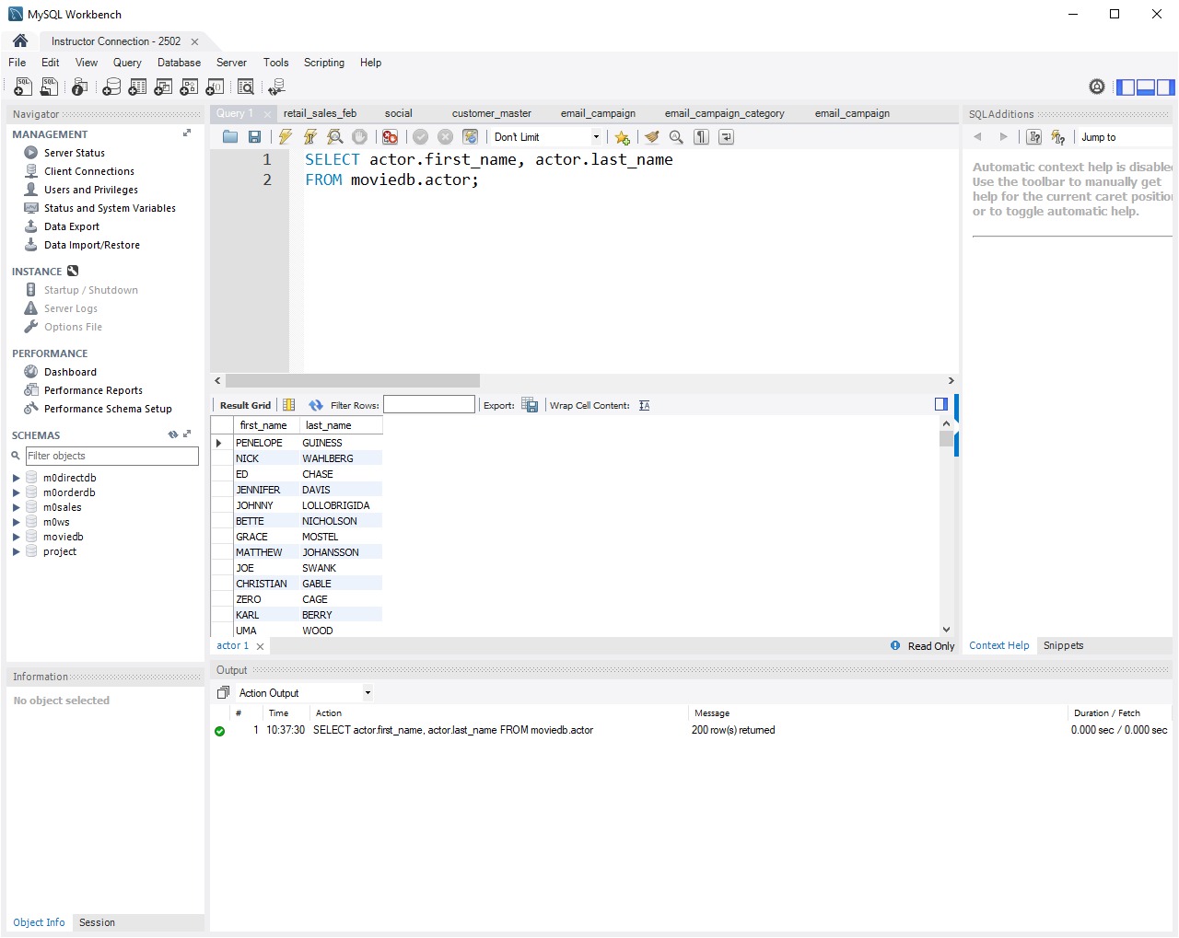
Requesting data from DB or using web API
JSON is used to package the data
MySQL Database Server
SELECT actor.first_name, actor.last_name FROM moviedb.actor;
PENELOPE GUINESS, NICK WAHLBERG, ED CHASE, JENNIFER DAVIS….
Database Server with Web API
https://swapi.co/api/people/1/?format=json
{"name":"Luke Skywalker","height":"172","mass":"77", "hair_color":"blond","skin_color":"fair“…

Slide 15
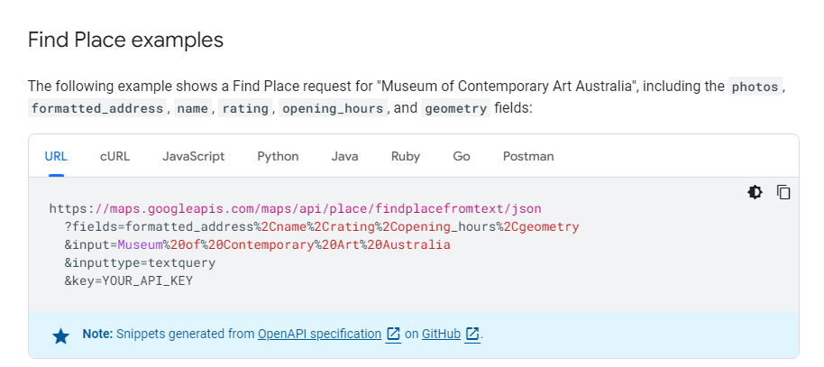

Slide 16
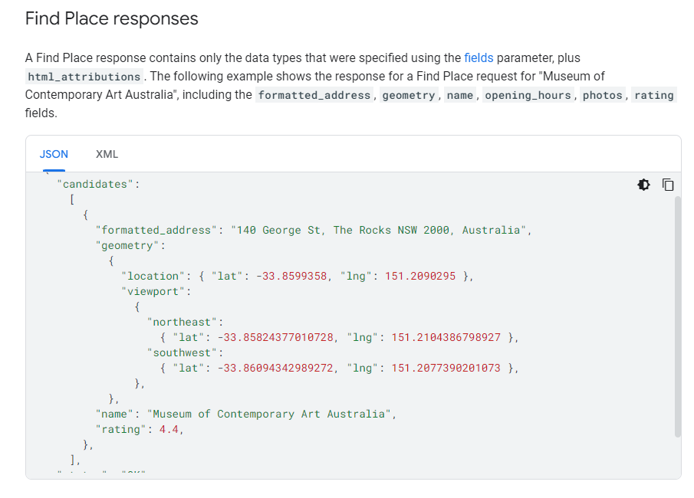

Slide 17
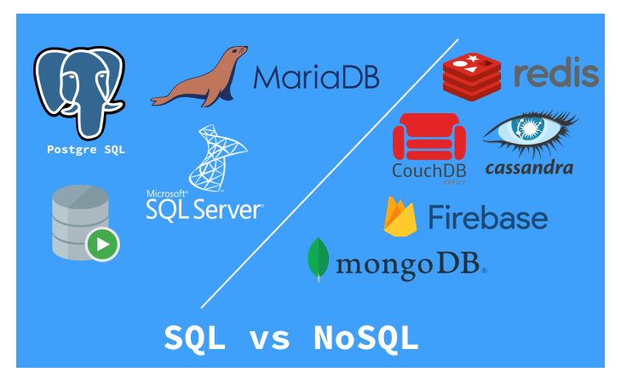
NoSQL Stands for Not Only SQL
A class of databases where data are not stored as tables (relations).
NoSQL good at handing semi-structured/unstructured data

Slide 18
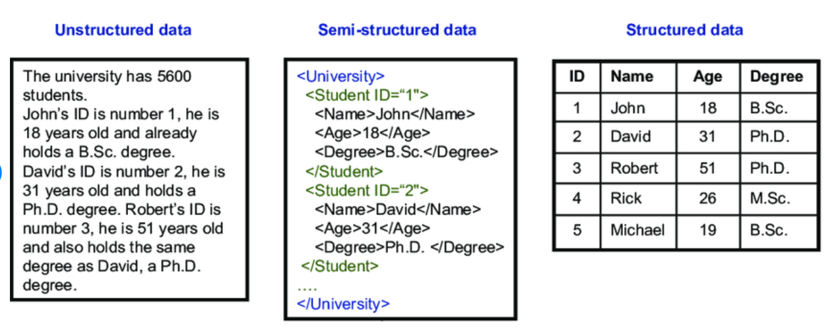
Convert semi-structured to structured

Slide 19
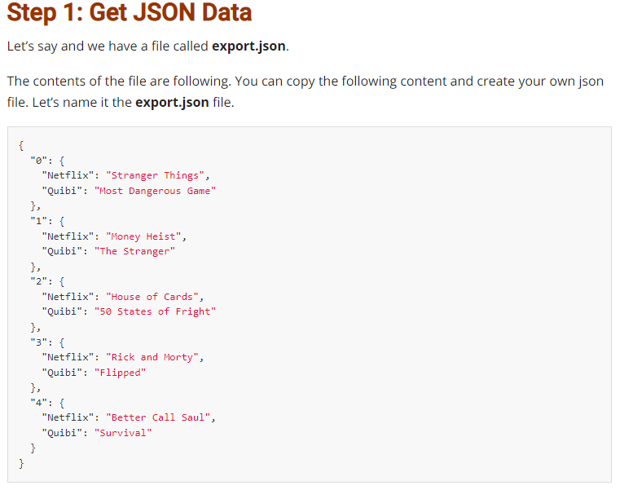
How to convert JSON to CSV?

Slide 20
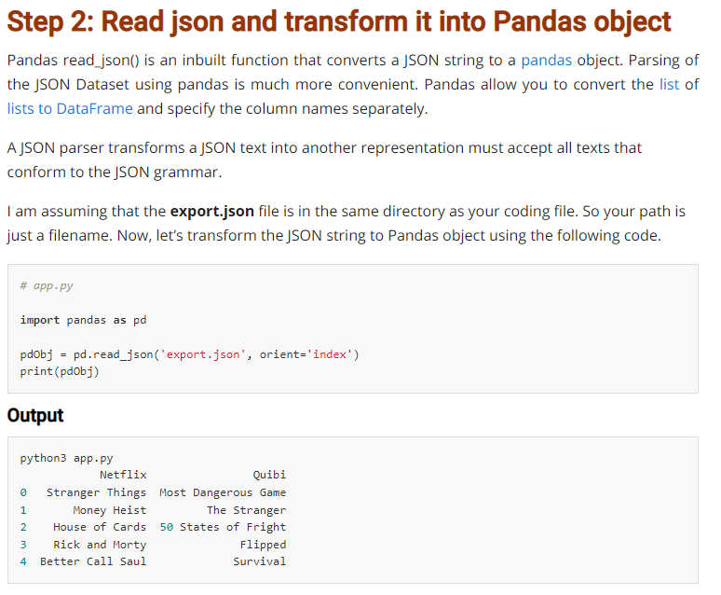
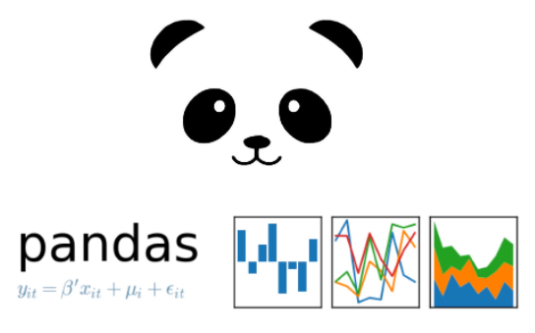
https://github.com/pandas-dev/pandas

Slide 21
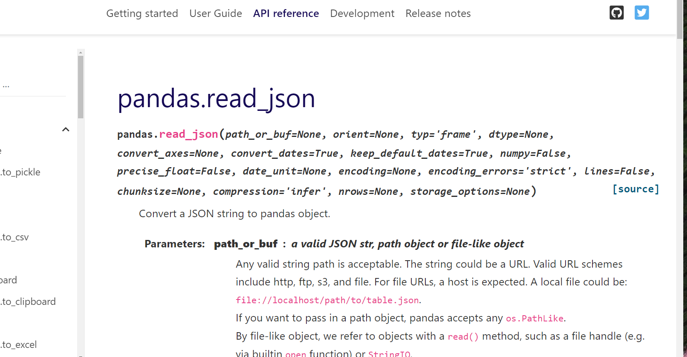
https://pandas.pydata.org/docs/reference/api/pandas.read_json.html

Slide 22
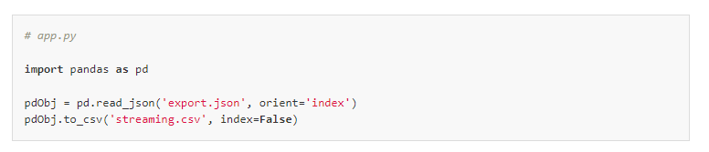
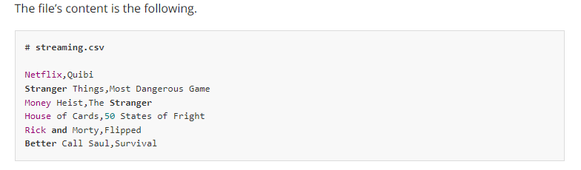

Slide 23
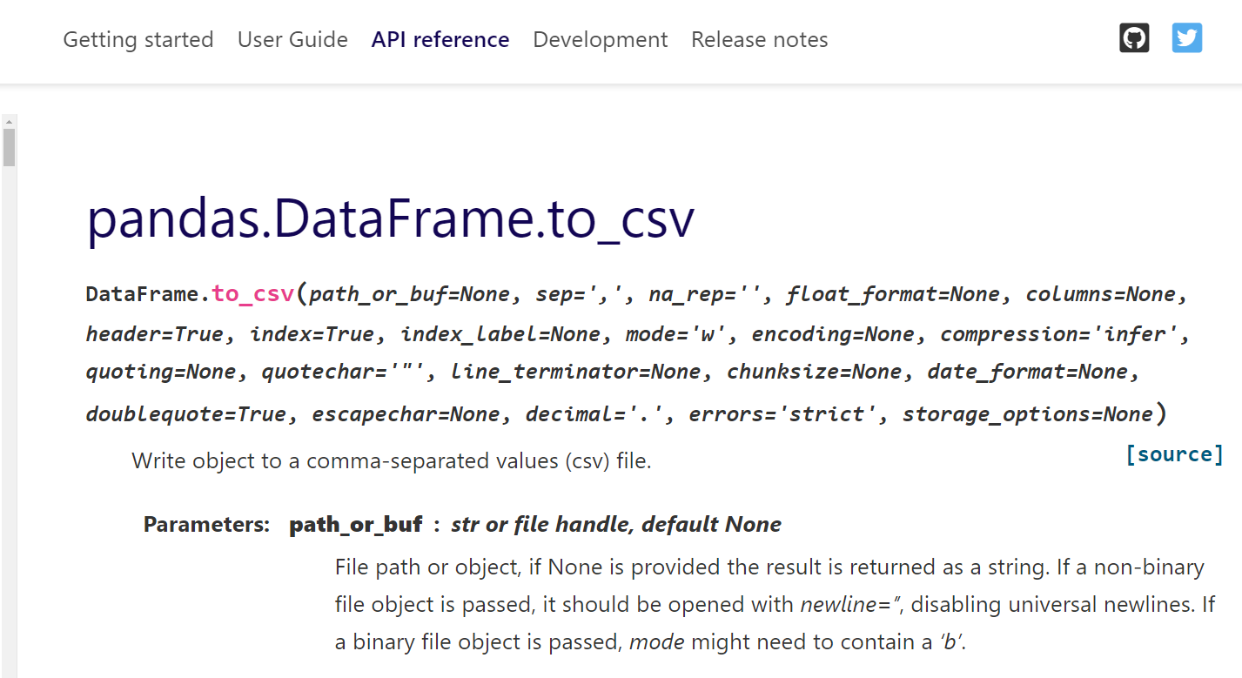
https://pandas.pydata.org/docs/reference/api/pandas.DataFrame.to_csv.html

Slide 24
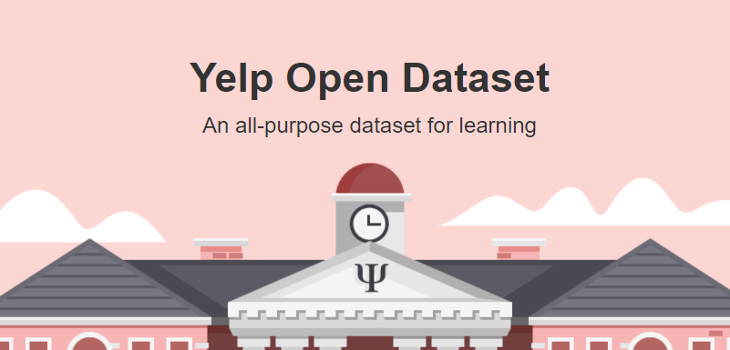
A low-level implementation example https://www.yelp.com/dataset

Slide 25
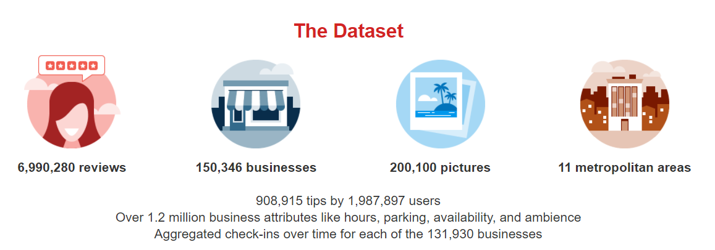
https://www.yelp.com/dataset/documentation/main

Slide 26
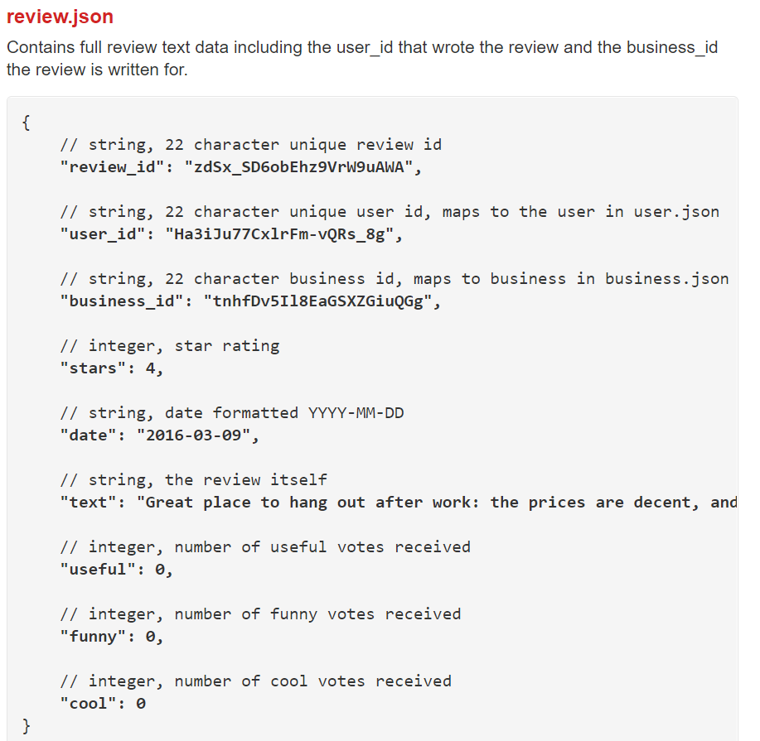

Slide 27
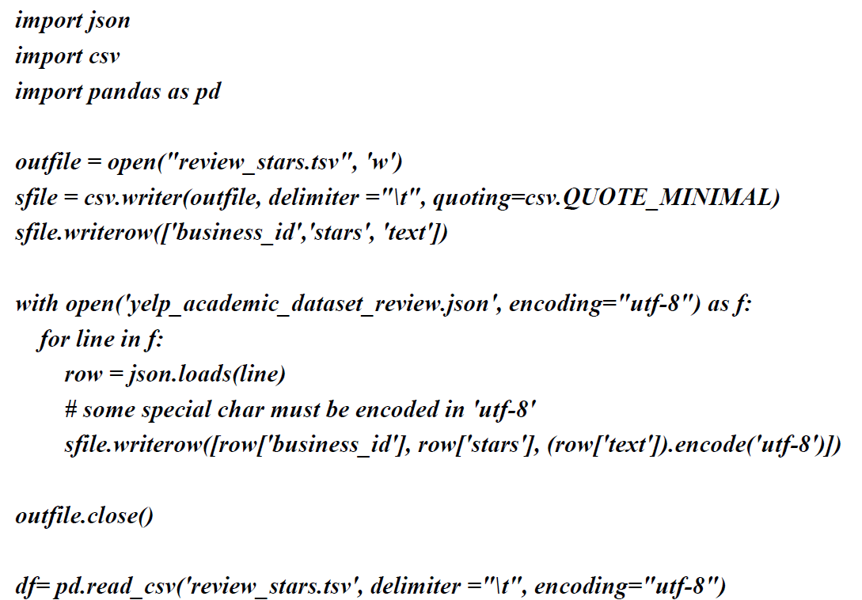
A low-level implementation using json library

